Slide 1
AdaBoostRegressor
AdaBoost algorithm, short for Adaptive Boosting, is a Boosting technique used as an Ensemble Method in ML. It is called Adaptive Boosting as the weights are re-assigned to each instance, with higher weights assigned to incorrectly classified instances.

Slide 2
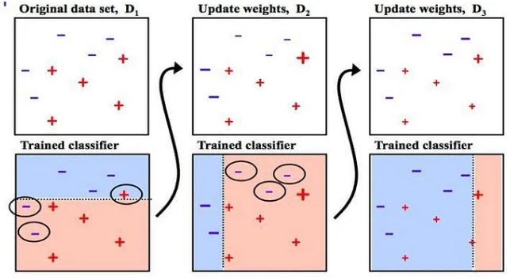
AdaBoostRegressor -Sequential training –Stump method

Slide 3
AdaBoostRegressor -Formulas
Calculating Total Error for the dataset (No of rows-5):
Total Error (TE) = 1/5.
Formula for calculating Performance of the Stump is
1/2ln((1-TE) / TE) =0.693
New Sample Weight for Misclassified data = Sample Weight * e^(Performance)
New Sample Weight for classified data = Sample Weight * e^- (Performance)

Slide 4

AdaBoostRegressor -Algorithm Coding in python:

Slide 5
XGBoosting:
It is similar to Gradient algorithm means Regularize the value at each step to find the less loss function and finalize the model.
But the difference is Gradient works in Sequential manner and XG works in parallel training of the data. So the performance will be high.
Training requires huge and complex data.

Slide 6
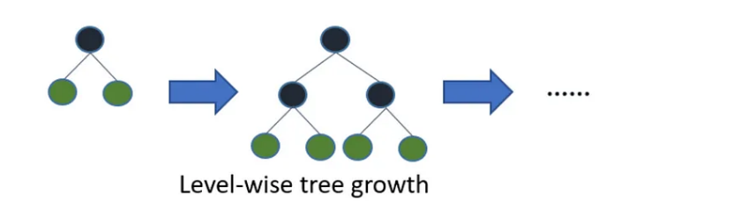
XGBoosting

Slide 7
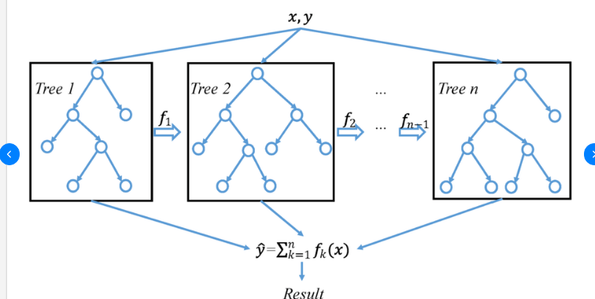
XGBoosting

Slide 8
LGBM Boosting:
This requires more data than XGBoost.
Won’t be suitable for smaller dataset.
DT is based on Leaf-wise growth:
Also use the histogram method to optimize the values.

Slide 9
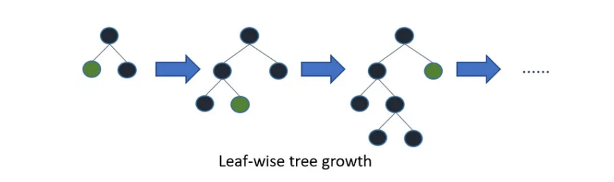
LGBM Boosting:

Slide 10
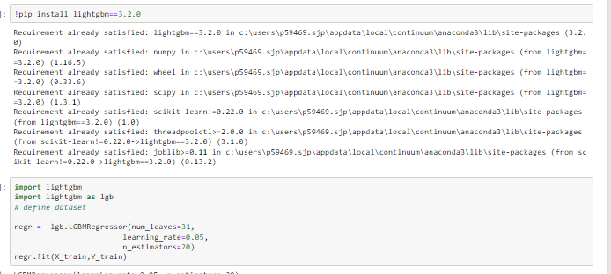
LGBM Boosting:

